Slide 1
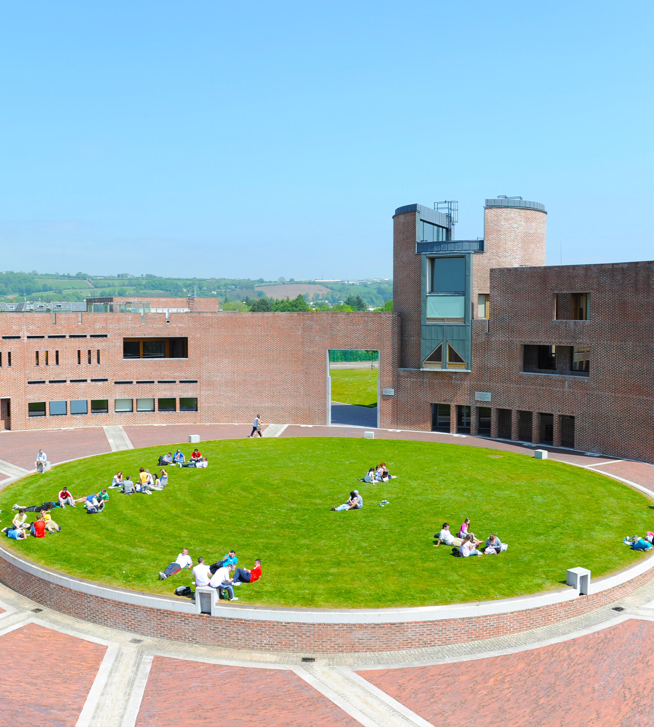

Creative Entrepreneurship
Presentation by
Gerard O’Donovan
29th May 2023

Slide 2
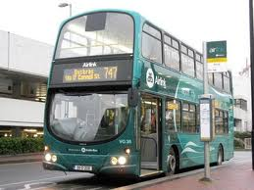
Business Ideas?
Business
“Business opportunities are like buses, there’s always another one coming.”
Notes:
2

Slide 3
Where to look
Business
Opportunities?
Problems to be solved?
Observation?
Tracking Future Trends?
Notes:
3

Slide 4
Problems to solve
Business
World hunger, global warming
Why can’t crops grow faster
Getting rid of cancer
Improving energy efficiency
How to live longer
Any others?
Notes:
4

Slide 5
Experiencing Enetrepreneurship
Business
Spend an afternoon walking around your college or town and don’t look for anything in particular
Observe the things you don’t normally see because you are in a hurry
Watch people what they do and don’t do
Write down all the thoughts based on these ideas and see what could become a business opportunity and why?

Slide 6
Musicians Have Already Good Entrepreneurship Traits
Business
Good Listeners
Connect with their audience
Failure is a daily routine, its called practice
Improvise
Innovate
Story Telling
Embrace the Struggle
Panos Panay
Notes:
6

Slide 7
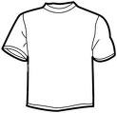
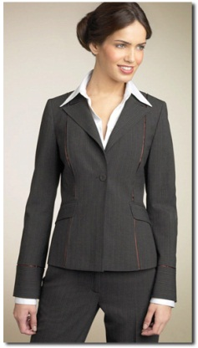

Creativity V’s Business
Business
T-Shirt v Suit ?
Successful creative entrepreneurs embrace both creativity and business.
“Turnover is vanity, profit is sanity and cash is reality” Adage
Notes:
7

Slide 8
What to luck for
Business
Limitations of what’s currently available
New and different approaches
Advances and breakthroughs
Unfilled niches
Trends and changes
Notes:
8

Slide 9
Sources of Ideas
Business
Personal interests or hobbies
Work experience, skills, abilities
Products and services familiar ones and unfamiliar ones
External Environment, opportunities in these sectors:
  Technological
  Societal Culture
  Demographics
  Economic
  Legal
  Political
Notes:
9

Slide 10
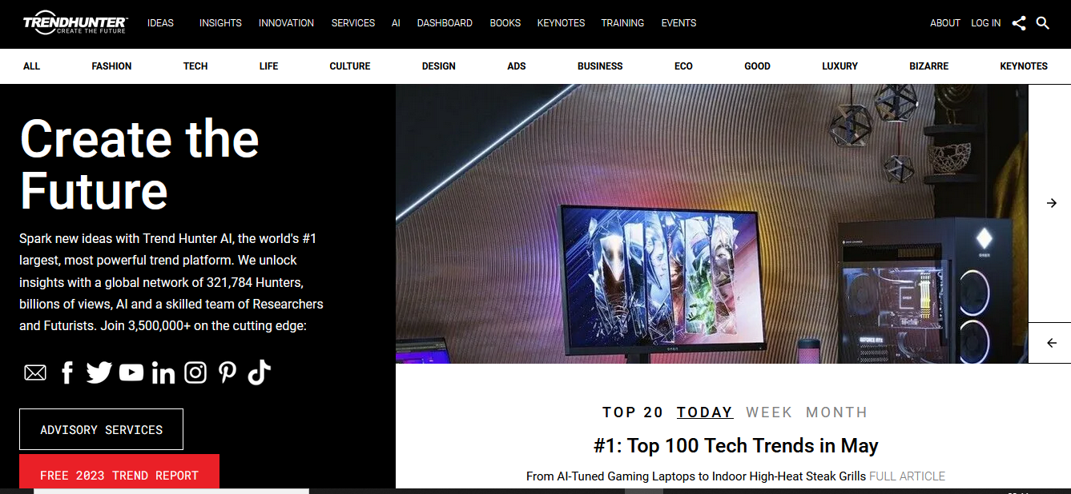

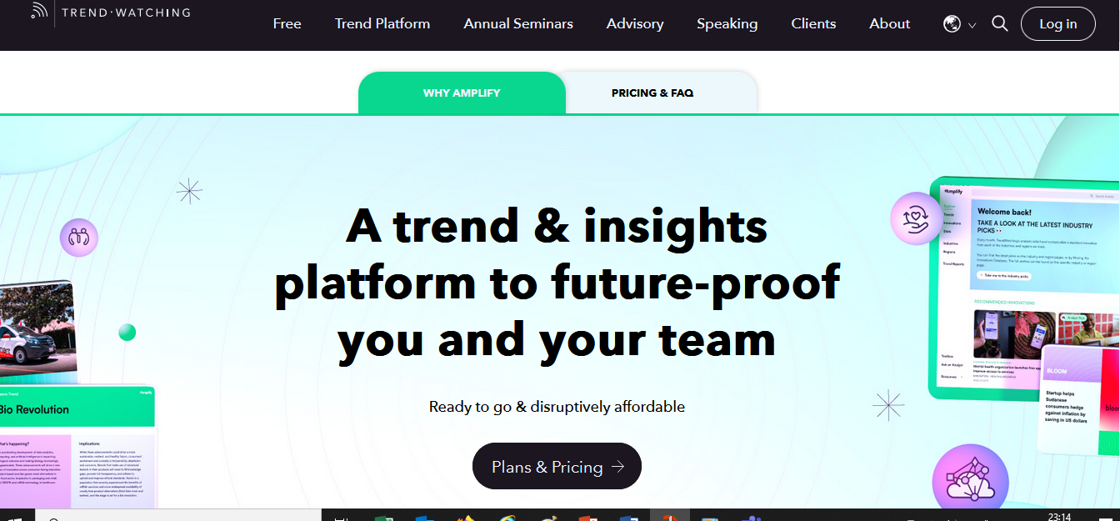

www.trendhunter.com
www.springwise.com
https://www.technologyreview.com
www.trendwatching.com

Slide 11
How To Use Trends To Find Business Ideas
Business
  Google Scholar
    e.g. Agricultural Trends
  Large Consulting Firms
    e.g. Sustainable Cities of the Future
Notes:
11

Slide 12
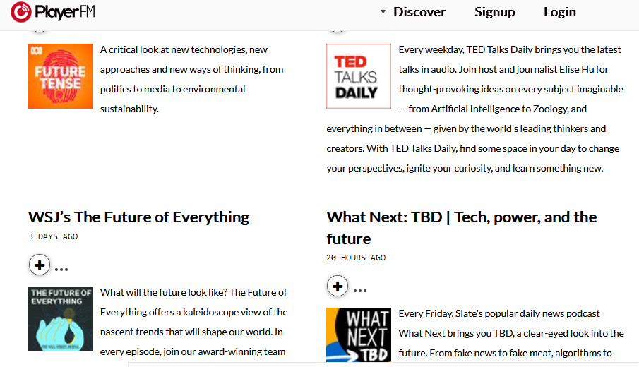
https://player.fm/podcasts/Future-Trends

Slide 13
Where will the opportunties be in the next decade
Business
Artificial Intelligence and machine learning
Sustainability
Health
Remote Working
Anything else?
Notes:
13

Slide 14
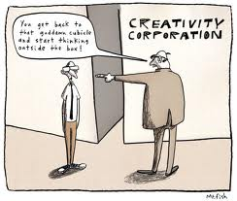
Thinking Outside the Box
Business
https://www.youtube.com/watch?v=ayV_N_q6JT0
https://www.youtube.com/watch?v=QYcXTlGLUgE&t=27s

Slide 15
Idea Checklist
Business
Does this idea work?
Will it continue to work?
Will people pay for it?
Will enough people pay for it?
Do you know how much it will cost you?
Do you know the needs of your customer?
Is it legal ?
Is it safe?
Notes:
15

Slide 16
Idea Checklist
Business
Are you aware of any competing products?
Do other people like your idea?
Do you know how much money you will need to get started?
Do you need special equipment?
Have you the required skills?
Notes:
16

Slide 17
Thank You. Questions welcome.
E-mail: gerard.odonovan@mtu.ie

